Slide 1

Notes:
<number>

Slide 2
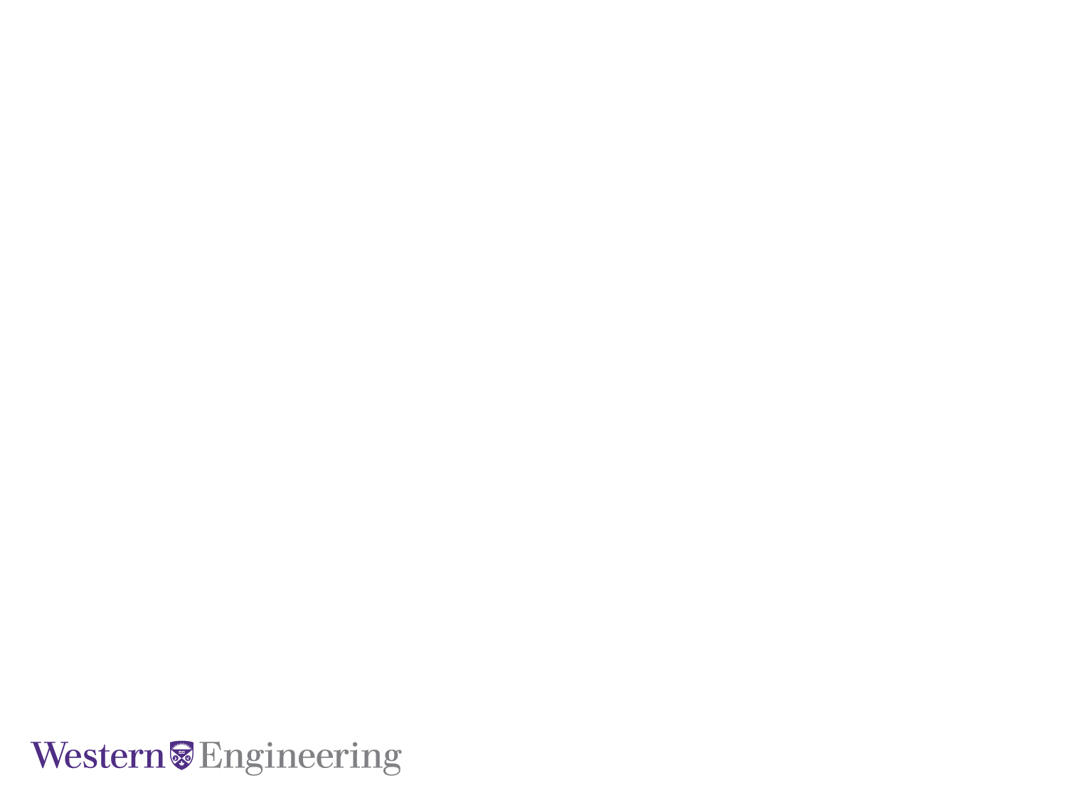
An Adaptive On-line
Framework For Novelty Streams
April, 2018
Jose Miguel Alves
Notes:
<number>

Slide 3
April, 2018
Agenda
Introduction
Methodology
Results
Data Analytics Course
Notes:
<number>

Slide 4
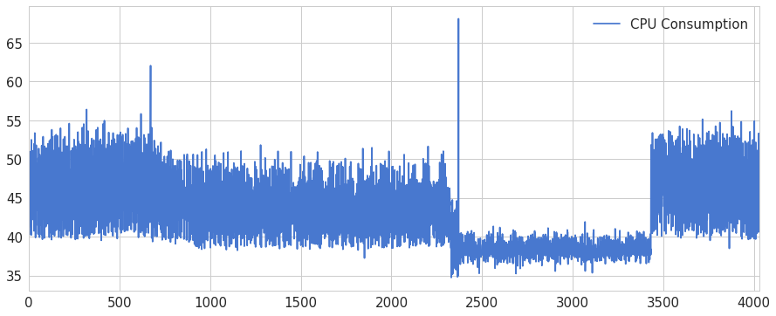
Introduction – Data Streams
A vast amount of data is generated continuously at high speed
Data streams are generate from non-stationary distributions
Data streams profiles are hardly ever constant
Notes:
Machine learning platform using CEP and Lambda Architecture
CEP process data streams events and Machine Learning models on the speed layer of Lambda Architecture
ML algorithms are created on the batch layer
Rules for the CEP can be generated by ML models
Platform provides an architecture for building different models e.g. anomaly detection, prediction, CEP automated rules, etc.
<number>

Slide 5
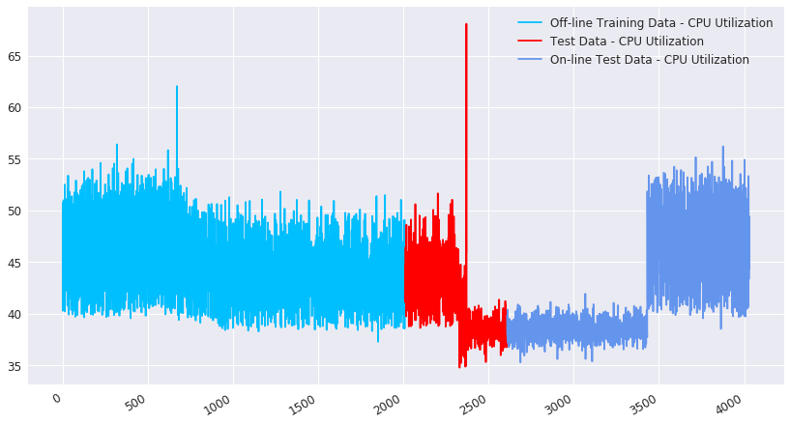
Introduction – Machine Learning in Data Streams
Machine Learning algorithms should be able to learn from off-line and on-line data
It’s common the presence of just positive examples during the off-line training
Off-line Data
On-line Data
Notes:
Machine learning platform using CEP and Lambda Architecture
CEP process data streams events and Machine Learning models on the speed layer of Lambda Architecture
ML algorithms are created on the batch layer
Rules for the CEP can be generated by ML models
Platform provides an architecture for building different models e.g. anomaly detection, prediction, CEP automated rules, etc.
<number>

Slide 6
Introduction – Novelty Detection
Possible to recognize novel profiles/concepts
Identify if the new online examples represent the normal behavior
One class-prediction
Examples of abnormal behavior are scarce
More difficult to get good results since counter-examples are not available
Research Proposal
Notes:
<number>

Slide 7
Adaptive On-line Framework For Novelty Detection in Data Streams
Feature Generation
Off-line Data Stream
Outliers Management
Off-line Training
Normalization
Feature Generation
On-line Data Stream
Autoencoder Model
Novelty Detection Engine
Normalization
On-line Training
Notes:
Machine learning platform using CEP and Lambda Architecture
CEP process data streams events and Machine Learning models on the speed layer of Lambda Architecture
ML algorithms are created on the batch layer
Rules for the CEP can be generated by ML models
Platform provides an architecture for building different models e.g. anomaly detection, prediction, CEP automated rules, etc.
<number>

Slide 8
Autoencoder
Autoencoder is used to reconstruct positive instances at output layer – trained just with positive layers
Positive instances (normal behavior) are expected to be reconstructed with a lower error than negative instances
A threshold based on the reconstruction error is defined to classify the data
Notes:
Machine learning platform using CEP and Lambda Architecture
CEP process data streams events and Machine Learning models on the speed layer of Lambda Architecture
ML algorithms are created on the batch layer
Rules for the CEP can be generated by ML models
Platform provides an architecture for building different models e.g. anomaly detection, prediction, CEP automated rules, etc.
<number>

Slide 9
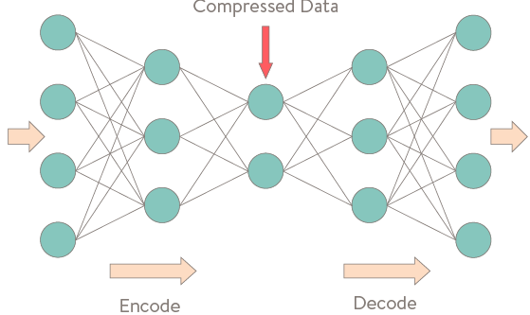
Autoencoder Model
Low Error: Test Data 1
Training Data
Test Data 1
High Error: Test Data 2
Test Data 2
Notes:
Autonomous Machine Learning Module
The main goal is to combine Machine Learning models built with offline data and online data to create an novel anomaly detection implementation
The anomaly detection model that can evolve during its operation and adapt to changes in the data stream independently of human intervention
This part of the project is being developed for the Data Analytics course
<number>

Slide 10
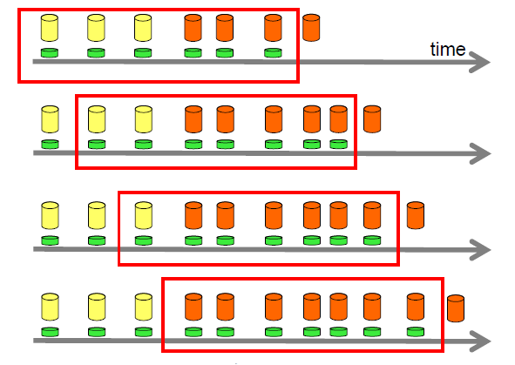
Novelty Detection Engine
After off-line training, a threshold is used to identify an abnormal error
If x instances are classified as abnormal, the model is retrained with the x instances
After the on-line training, a new threshold is defined
Retraining
Notes:
Machine learning platform using CEP and Lambda Architecture
CEP process data streams events and Machine Learning models on the speed layer of Lambda Architecture
ML algorithms are created on the batch layer
Rules for the CEP can be generated by ML models
Platform provides an architecture for building different models e.g. anomaly detection, prediction, CEP automated rules, etc.
<number>

Slide 11
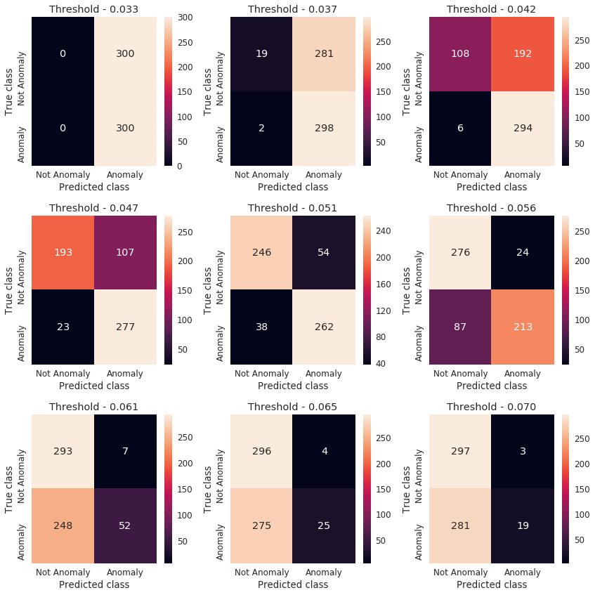
Novelty Detection Engine – Thresholds
Notes:
Machine learning platform using CEP and Lambda Architecture
CEP process data streams events and Machine Learning models on the speed layer of Lambda Architecture
ML algorithms are created on the batch layer
Rules for the CEP can be generated by ML models
Platform provides an architecture for building different models e.g. anomaly detection, prediction, CEP automated rules, etc.
<number>

Slide 12
Methodology – Dataset
NAB Dataset: Anomaly Detection Beenchmark
A real dataset with measures of CPU utilization was used
Training, Test, Online Test / Operation: 50%, 15%, 35%
Notes:
Machine learning platform using CEP and Lambda Architecture
CEP process data streams events and Machine Learning models on the speed layer of Lambda Architecture
ML algorithms are created on the batch layer
Rules for the CEP can be generated by ML models
Platform provides an architecture for building different models e.g. anomaly detection, prediction, CEP automated rules, etc.
<number>

Slide 13
Methodology – Data Preprocessing
Outliners - IQR filter
Normalization
Feature Generation from date attributes
Window generation – 21 observations with 3 measures skipped between each window
Notes:
Machine learning platform using CEP and Lambda Architecture
CEP process data streams events and Machine Learning models on the speed layer of Lambda Architecture
ML algorithms are created on the batch layer
Rules for the CEP can be generated by ML models
Platform provides an architecture for building different models e.g. anomaly detection, prediction, CEP automated rules, etc.
<number>

Slide 14
Methodology - Evaluation
Model was evaluated at 3 different moments
The test data contained positive instances and negative instances
Evaluation Metrics: precision, recall,
First Evaluation
Third Evaluation
Second Evaluation
Notes:
Machine learning platform using CEP and Lambda Architecture
CEP process data streams events and Machine Learning models on the speed layer of Lambda Architecture
ML algorithms are created on the batch layer
Rules for the CEP can be generated by ML models
Platform provides an architecture for building different models e.g. anomaly detection, prediction, CEP automated rules, etc.
<number>

Slide 15
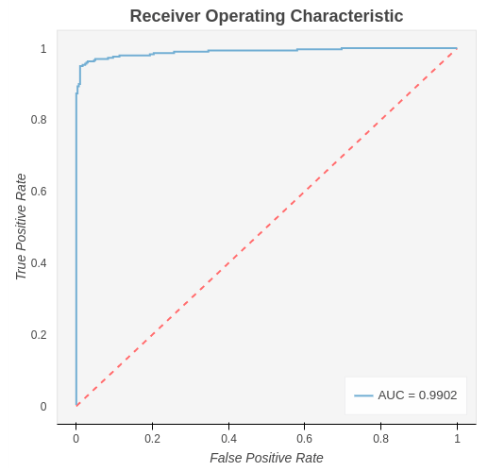
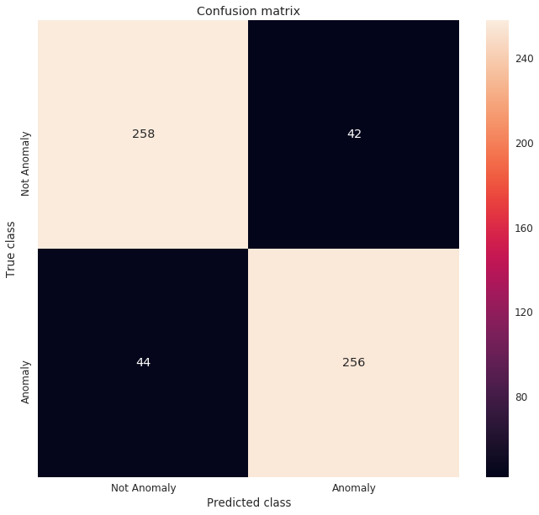
Results – First Evaluation
Evaluation performed after off-line training
Notes:
Machine learning platform using CEP and Lambda Architecture
CEP process data streams events and Machine Learning models on the speed layer of Lambda Architecture
ML algorithms are created on the batch layer
Rules for the CEP can be generated by ML models
Platform provides an architecture for building different models e.g. anomaly detection, prediction, CEP automated rules, etc.
<number>

Slide 16
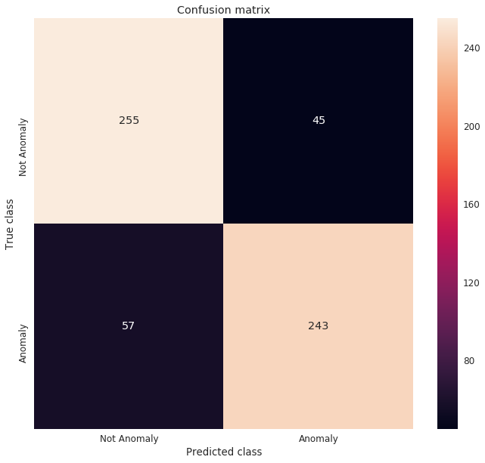
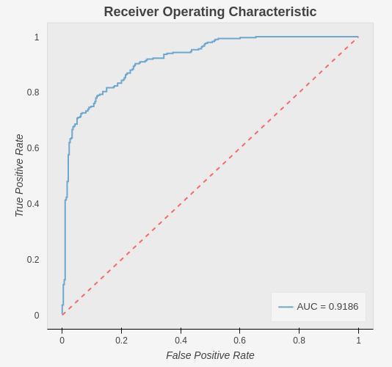
Results – Second Evaluation
Evaluation performed on model generated over on-line training when the second concept shows
Notes:
Machine learning platform using CEP and Lambda Architecture
CEP process data streams events and Machine Learning models on the speed layer of Lambda Architecture
ML algorithms are created on the batch layer
Rules for the CEP can be generated by ML models
Platform provides an architecture for building different models e.g. anomaly detection, prediction, CEP automated rules, etc.
<number>

Slide 17
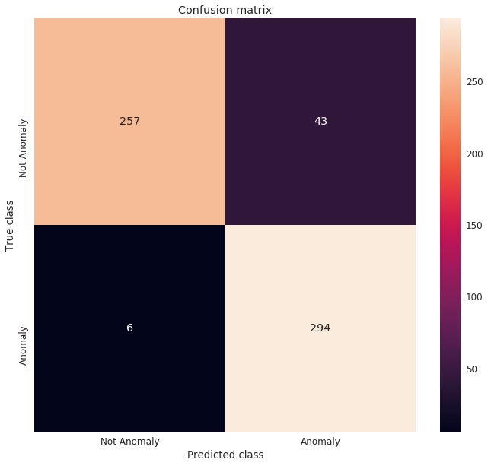
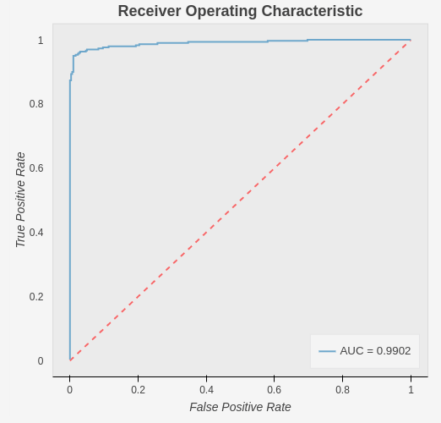
Results – Second Evaluation
Evaluation performed on model generated over on-line training when the second concept shows
Notes:
Machine learning platform using CEP and Lambda Architecture
CEP process data streams events and Machine Learning models on the speed layer of Lambda Architecture
ML algorithms are created on the batch layer
Rules for the CEP can be generated by ML models
Platform provides an architecture for building different models e.g. anomaly detection, prediction, CEP automated rules, etc.
<number>

Slide 18
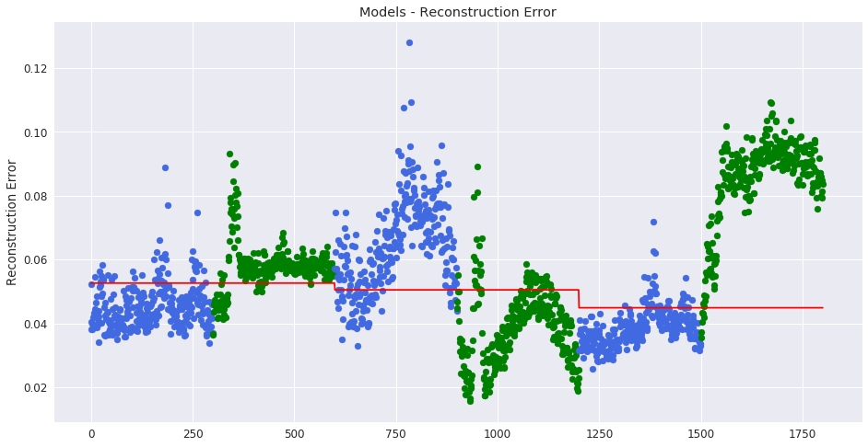
Results
Over on-line operation model was retrained 6 times automatically
The model was able to detect a change in the data and it learned the normal behaviour 2 times as expected
Notes:
Machine learning platform using CEP and Lambda Architecture
CEP process data streams events and Machine Learning models on the speed layer of Lambda Architecture
ML algorithms are created on the batch layer
Rules for the CEP can be generated by ML models
Platform provides an architecture for building different models e.g. anomaly detection, prediction, CEP automated rules, etc.
<number>

Slide 19
Notes:
<number>

